Slide 1
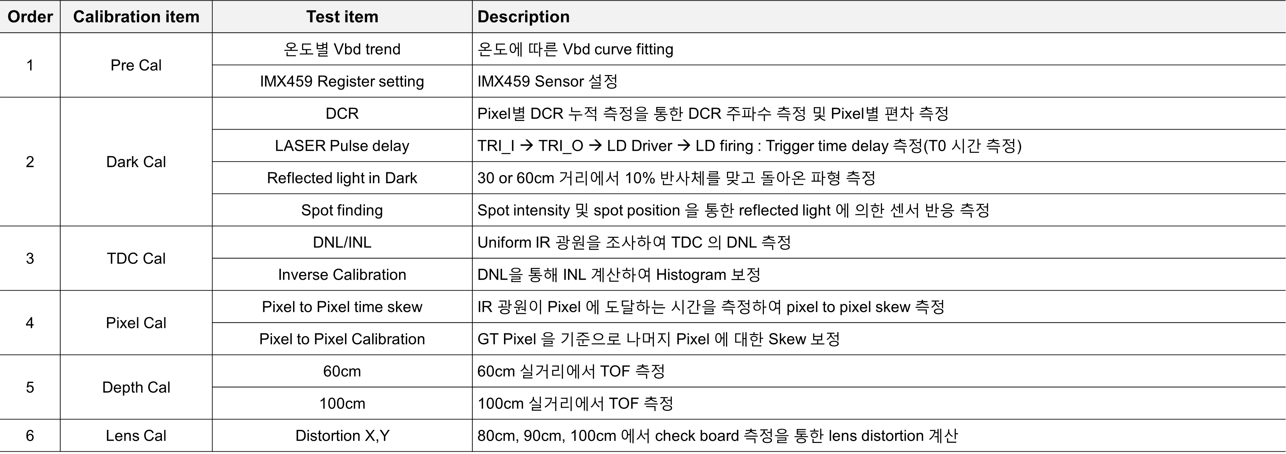
S-LiDAR Cal. (Dark, TDC, P2P)
Item | 인원 | 6월2주 | 6월3주 | 6월4주 | 7월1주 | 7월2주 | 7월3주 | 7월4주 | 8월1주 | 8월2주 | 8월3주 | 8월4주 | 11월
Dark, TDC, P2P Cal. 장비 | 성동현 이동건 이석민
DNL용
IR 광원
발주
P2P
광원설계
TDC
Cal
검증
w/ IR광원
통합
Cal
장비개발
의사결정
통합
Cal
장비
설계
통합
Cal
장비
발주
EVK
입고
P2P
장비
발주
Dark
Cal
검증
실거리
TOF
Chart
측정
P2P
입고
검증
입고
ACE d-TOF Sensor Calibration 방식을 자사 S-LiDAR 에 적용
전반적이 Calibration 의 방식은 동일하지만 자사 S-LiDAR 에 적합한 장비 구성으로 Modification

Slide 2
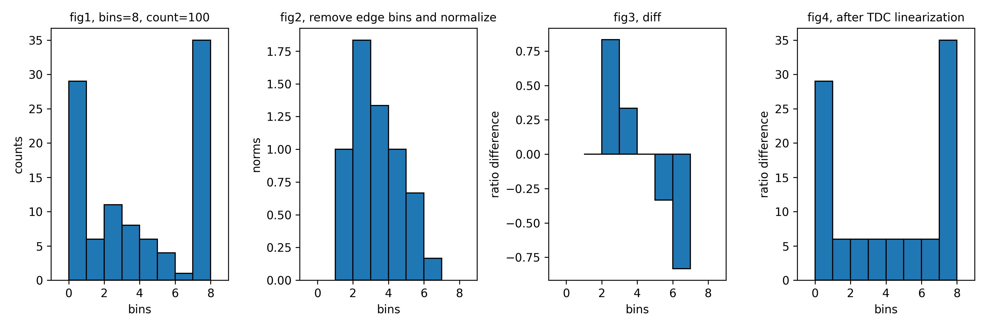
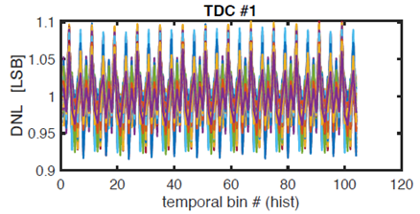

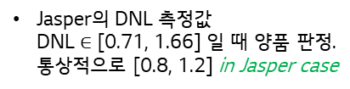
Lens Calibration
Jasper Calibration BM process
Dark Box
LPFF
Rail
P2P
$t_{0}$ measure
Spot finding
TDC Linearization.
Geo Cal.
Depth Cal.
FPN Cal.
LPFF TDC Linearization
Definition of Differential Non-Linearity
A Python test code for the TDC linearization
11
11
Ideal TDC
Real TDC
$$DNL\left(11\right)=0 LSB$$
10
10
$$DNL\left(10\right)=−0.3 LSB$$
01
01
00
V (LSB)
00
$$DNL\left(01\right)=0.5 LSB$$
V (LSB)
$$DNL\left(00\right)=−0.2 LSB$$
Jasper의 DNL 측정값 DNL $∈$ [0.71, 1.66] 일 때 양품 판정. 통상적으로 [0.8, 1.2] in Jasper case

Slide 3




Lens Calibration
Summarized Lens Calibration process
Print a pattern and attach it to a planar surface.
Take several images with different locations and orientations by moving either the plane or camera.
Detect the corners of the chessboard.
Estimate intrinsic and extrinsic parameters.
Refine the found parameters.
Obtain the distortion parameters and undistort the image.
Repeat 4~6 until all the parameters converge.
Harry’s operator
Forstner’s algorithm
Suzuki’s algorithm
Alexander’s algorithm
etc.
$←$ Corner detector algorithm.
$←$ Zhang’s technique.
$←$ The Levenberg-Marquardt algorithm.
$←$ The Brown-Conrady model.

Slide 4


고객가치
새로운 시도
집요한 실행
The Levenberg-Marquartdt Algorithm

Slide 5
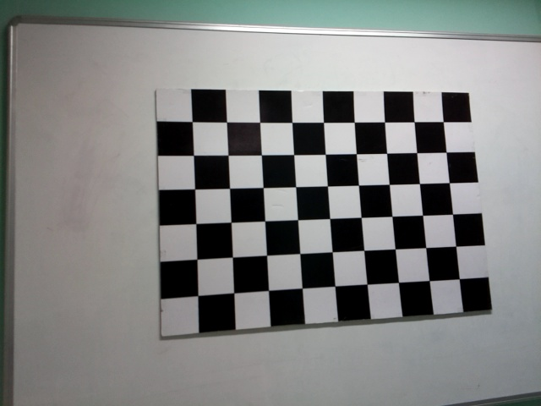
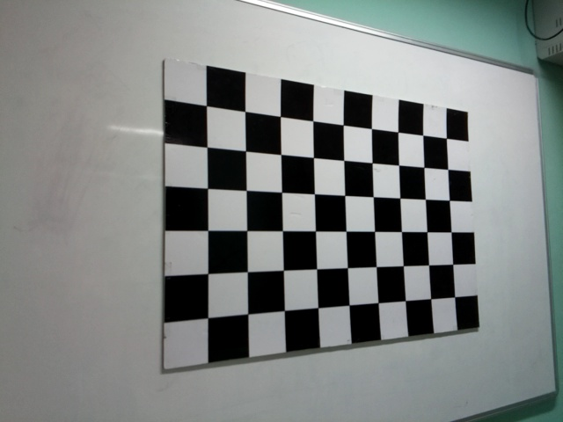
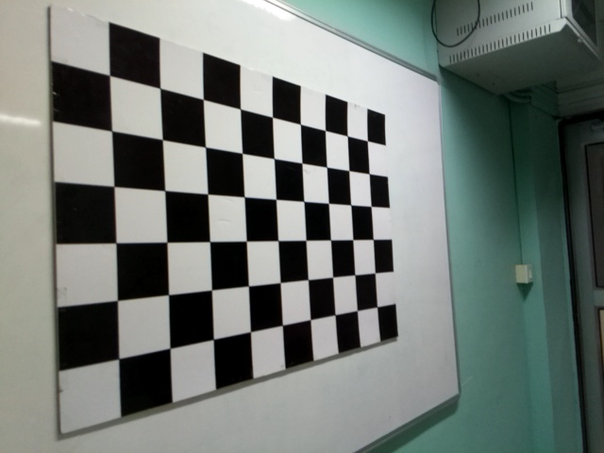


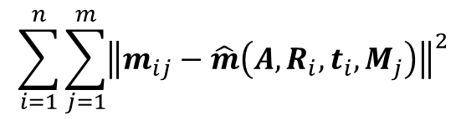

Lens Calibration
Maximum likelihood estimation
The maximum likelihood estimation can be obtained by minimizing the followings:
Zhengyou Zhang’s technique
$$\sum_{i=1}^{n}{\sum_{j=1}^{m}{{\left\|m_{ij}−\hat{m}\left(A,R_{i},t_{i},M_{j}\right)\right\|}^{2}}}$$
where $\hat{m}\left(A,R_{i},t_{i},M_{j}\right)$ is the projection of point $M_{j}$ in image $i$ and $m_{ij}$ is the ideal coordinate of a point in an image plane.
$i$th image
$$⋯$$
$$⋯$$

Slide 6
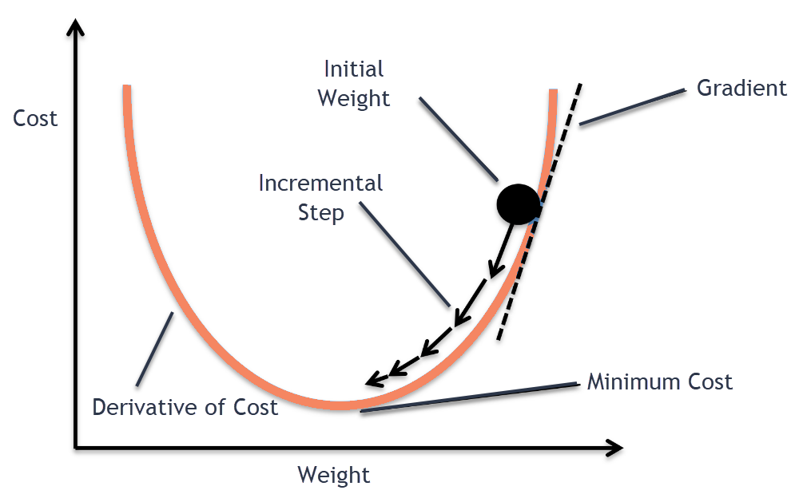


Lens Calibration
What is the optimization algorithm?
Determining the direction and step side to minimize or maximize the cost, loss, error, or profit function.
Various optimization algorithms for the non-linear least squares problem:
Gradient Descent.
Gauss-Newton method.
Levenberg method = GD + GN
Levenberg-Marquartdt method = Modified Levenberg
$$x_{k+1}$$
$$x_{k}$$

Slide 7
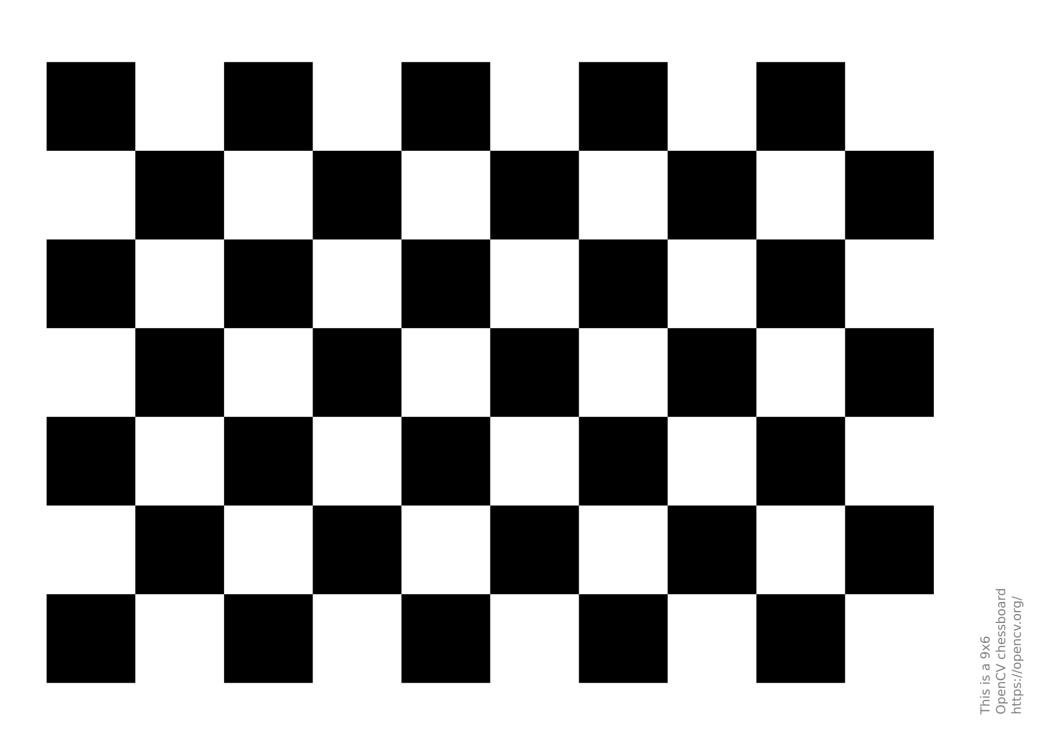

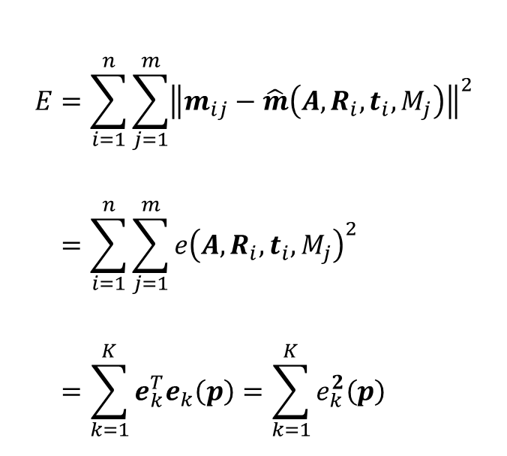
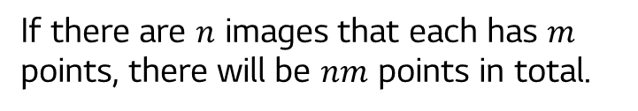

Lens Calibration
Gradient Descent method
1st image
For simplicity, we define the error function as:
$$E=\sum_{i=1}^{n}{\sum_{j=1}^{m}{{\left\|m_{ij}−\hat{m}\left(A,R_{i},t_{i},M_{j}\right)\right\|}^{2}}} \\ =\sum_{i=1}^{n}{\sum_{j=1}^{m}{{e\left(A,R_{i},t_{i},M_{j}\right)}^{2}}} \\ =\sum_{k=1}^{K}{e_{k}^{T}e_{k}\left(p\right)}=\sum_{k=1}^{K}{e_{k}^{2}\left(p\right)}$$
2nd image
i^{th} image
The magnitude of displacement: $e_{k}$
$j$th point
If there are $n$ images that each has $m$ points, there will be $nm$ points in total.
where $K=nm$, $e=\left\|m_{ij}−\hat{m}\left(p\right)\right\|$ and $p=\left(A,R_{i},t_{i},M_{j}\right)$.
$e_{k}^{2}$ 는 에러의 제곱. 모든 점에 대한 에러의 제곱을 다 더하여, 그 값이 최소가 되는 $p$ 찾는 것.

Slide 8


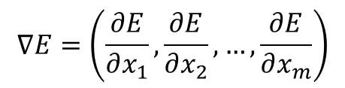
Lens Calibration
Gradient Descent method
Definition of the gradient of a function.
$$∇E=\left(\frac{∂E}{∂x_{1}},\frac{∂E}{∂x_{2}},…,\frac{∂E}{∂x_{m}}\right)$$
$$p_{k+1}=p_{k}−λ_{k}∇E\left(p_{k}\right), k≥0$$
Note that the step size (or learning rate) $λ_{k}$ is allowed to change at every step.
$$x_{k+1}$$
$$x_{k}$$

Slide 9


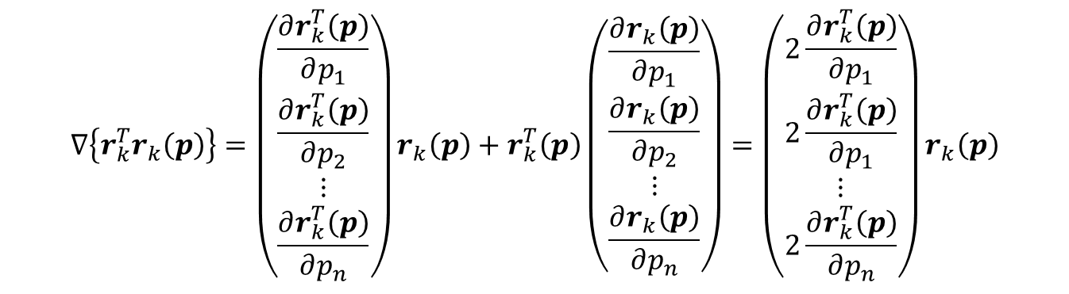
Lens Calibration
Gradient Descent method
$$∇E=∇\sum_{k=1}^{K}{e_{k}^{2}\left(p\right)}=\sum_{k=1}^{K}{∇e_{k}^{2}\left(p\right)}=\sum_{k=1}^{K}{∇\left\{r_{k}^{T}r_{k}\left(p\right)\right\}}$$
where $r_{k}\left(p\right)=\left(\begin{matrix}r_{k,x}\left(p\right) \\ r_{k,y}\left(p\right)\end{matrix}\right)$, the coordinate of the $k$th point and $e_{k}\left(p\right)=\sqrt{r_{k,x}^{2}\left(p\right)+r_{k.y}^{2}\left(p\right)}$
Since $\frac{∂r_{k}^{T}\left(p\right)}{∂p_{1}}r_{k}\left(p\right)=\left(\begin{matrix}\frac{∂r_{k,x}}{∂p_{1}} & \frac{∂r_{k,y}}{∂p_{1}}\end{matrix}\right)\left(\begin{matrix}r_{k,x} \\ r_{k,y}\end{matrix}\right)=r_{k}^{T}\left(p\right)\frac{∂r_{k}\left(p\right)}{∂p_{1}}$,
$$∇\left\{r_{k}^{T}r_{k}\left(p\right)\right\}=\left(\begin{matrix}\frac{∂r_{k}^{T}\left(p\right)}{∂p_{1}} \\ \frac{∂r_{k}^{T}\left(p\right)}{∂p_{2}} \\ ⋮ \\ \frac{∂r_{k}^{T}\left(p\right)}{∂p_{n}}\end{matrix}\right)r_{k}\left(p\right)+r_{k}^{T}\left(p\right)\left(\begin{matrix}\frac{∂r_{k}\left(p\right)}{∂p_{1}} \\ \frac{∂r_{k}\left(p\right)}{∂p_{2}} \\ ⋮ \\ \frac{∂r_{k}\left(p\right)}{∂p_{n}}\end{matrix}\right)=\left(\begin{matrix}2\frac{∂r_{k}^{T}\left(p\right)}{∂p_{1}} \\ 2\frac{∂r_{k}^{T}\left(p\right)}{∂p_{1}} \\ ⋮ \\ 2\frac{∂r_{k}^{T}\left(p\right)}{∂p_{n}}\end{matrix}\right)r_{k}\left(p\right)$$

Slide 10
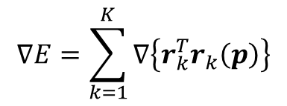
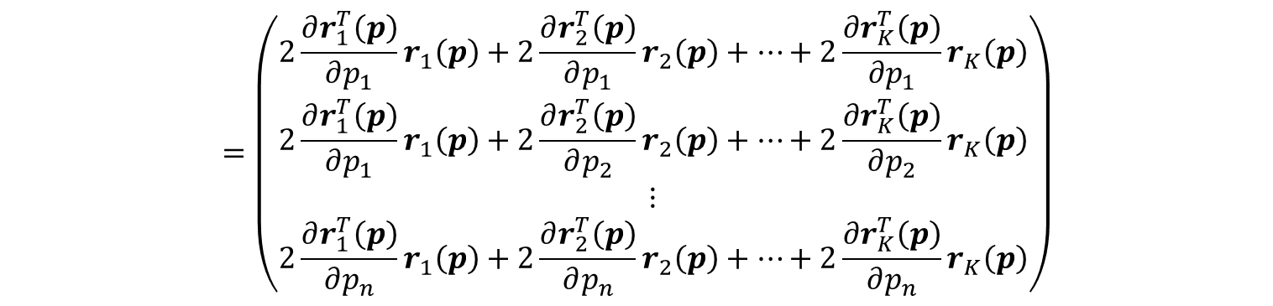
Lens Calibration
Gradient Descent method
$$∇E=\sum_{k=1}^{K}{∇\left\{r_{k}^{T}r_{k}\left(p\right)\right\}}$$
$$=\left(\begin{matrix}2\frac{∂r_{1}^{T}\left(p\right)}{∂p_{1}}r_{1}\left(p\right)+2\frac{∂r_{2}^{T}\left(p\right)}{∂p_{1}}r_{2}\left(p\right)+…+2\frac{∂r_{K}^{T}\left(p\right)}{∂p_{1}}r_{K}\left(p\right) \\ 2\frac{∂r_{1}^{T}\left(p\right)}{∂p_{1}}r_{1}\left(p\right)+2\frac{∂r_{2}^{T}\left(p\right)}{∂p_{2}}r_{2}\left(p\right)+…+2\frac{∂r_{K}^{T}\left(p\right)}{∂p_{2}}r_{K}\left(p\right) \\ ⋮ \\ 2\frac{∂r_{1}^{T}\left(p\right)}{∂p_{n}}r_{1}\left(p\right)+2\frac{∂r_{2}^{T}\left(p\right)}{∂p_{n}}r_{2}\left(p\right)+…+2\frac{∂r_{K}^{T}\left(p\right)}{∂p_{n}}r_{K}\left(p\right)\end{matrix}\right)$$

Slide 11

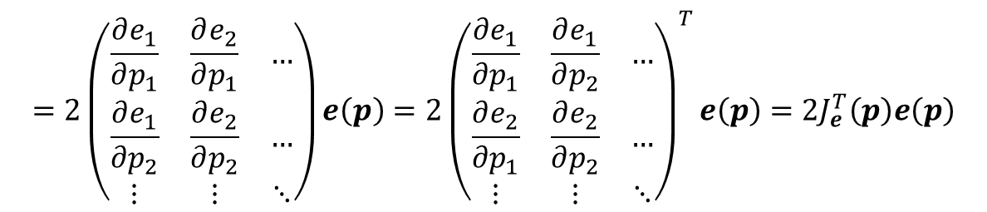
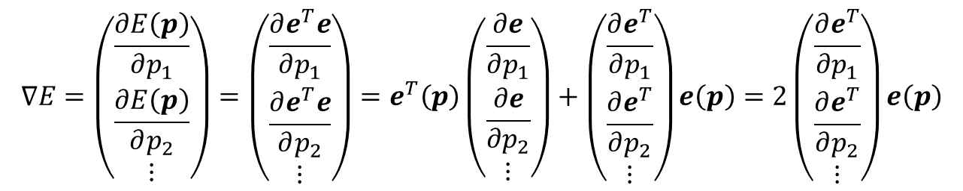
Lens Calibration
Gradient Descent method
$$E=\sum_{k=1}^{K}{e_{k}^{2}\left(p\right)}=\left(\begin{matrix}e_{1}\left(p\right) & e_{2}\left(p\right) & …\end{matrix}\right)\left(\begin{matrix}e_{1}\left(p\right) \\ e_{2}\left(p\right) \\ ⋮\end{matrix}\right)=e^{T}e$$
$$∇E=\left(\begin{matrix}\frac{∂E\left(p\right)}{∂p_{1}} \\ \frac{∂E\left(p\right)}{∂p_{2}} \\ ⋮\end{matrix}\right)=\left(\begin{matrix}\frac{∂e^{T}e}{∂p_{1}} \\ \frac{∂e^{T}e}{∂p_{2}} \\ ⋮\end{matrix}\right)=e^{T}\left(p\right)\left(\begin{matrix}\frac{∂e}{∂p_{1}} \\ \frac{∂e}{∂p_{2}} \\ ⋮\end{matrix}\right)+\left(\begin{matrix}\frac{∂e^{T}}{∂p_{1}} \\ \frac{∂e^{T}}{∂p_{2}} \\ ⋮\end{matrix}\right)e\left(p\right)=2\left(\begin{matrix}\frac{∂e^{T}}{∂p_{1}} \\ \frac{∂e^{T}}{∂p_{2}} \\ ⋮\end{matrix}\right)e\left(p\right)$$
$$=2\left(\begin{matrix}\frac{∂e_{1}}{∂p_{1}} & \frac{∂e_{2}}{∂p_{1}} & … \\ \frac{∂e_{1}}{∂p_{2}} & \frac{∂e_{2}}{∂p_{2}} & … \\ ⋮ & ⋮ & ⋱\end{matrix}\right)e\left(p\right)=2{\left(\begin{matrix}\frac{∂e_{1}}{∂p_{1}} & \frac{∂e_{1}}{∂p_{2}} & … \\ \frac{∂e_{2}}{∂p_{1}} & \frac{∂e_{2}}{∂p_{2}} & … \\ ⋮ & ⋮ & ⋱\end{matrix}\right)}^{T}e\left(p\right)=2J_{e}^{T}\left(p\right)e\left(p\right)$$

Slide 12
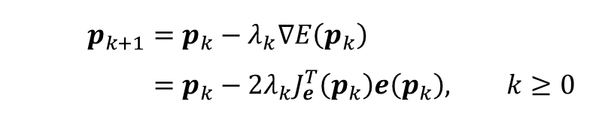
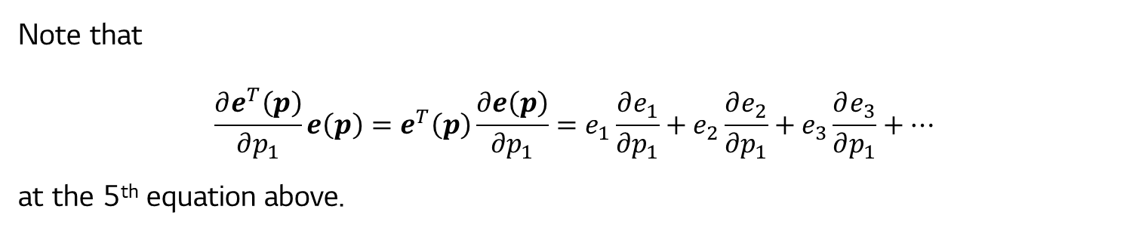
Lens Calibration
Gradient Descent method
Note that
$$\frac{∂e^{T}\left(p\right)}{∂p_{1}}e\left(p\right)=e^{T}\left(p\right)\frac{∂e\left(p\right)}{∂p_{1}}=e_{1}\frac{∂e_{1}}{∂p_{1}}+e_{2}\frac{∂e_{2}}{∂p_{1}}+e_{3}\frac{∂e_{3}}{∂p_{1}}+…$$
at the 5th equation above.
Then the gradient descent method for the multivariable function becomes:
$$p_{k+1}=p_{k}−λ_{k}∇E\left(p_{k}\right) \\ =p_{k}−2λ_{k}J_{e}^{T}\left(p_{k}\right)e\left(p_{k}\right), k≥0$$

Slide 13
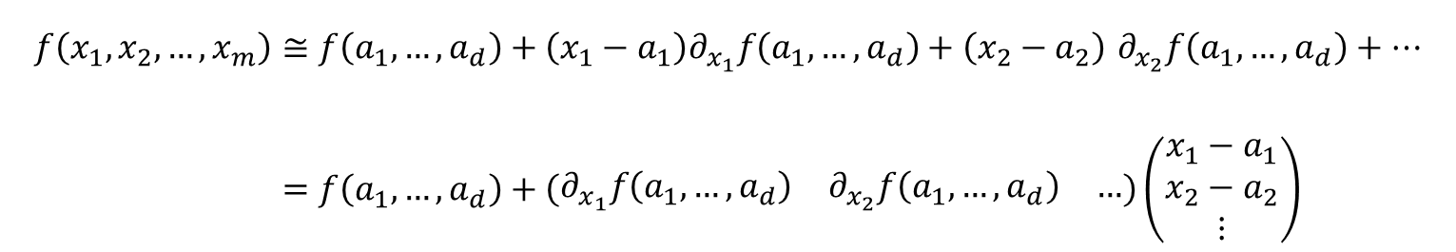
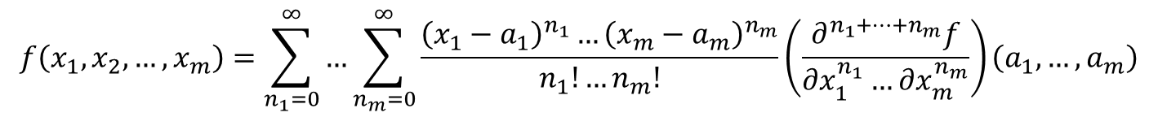
Lens Calibration
The Gauss-Newton method
Taylor series in multiple variables.
$$f\left(x_{1},x_{2},…,x_{m}\right)=\sum_{n_{1}=0}^{∞}{…\sum_{n_{m}=0}^{∞}{\frac{{\left(x_{1}−a_{1}\right)}^{n_{1}}…{\left(x_{m}−a_{m}\right)}^{n_{m}}}{n_{1}!…n_{m}!}\left(\frac{∂^{n_{1}+…+n_{m}}f}{∂x_{1}^{n_{1}}…∂x_{m}^{n_{m}}}\right)\left(a_{1},…,a_{m}\right)}}$$
Taylor series to the first-order is then,
$$f\left(x_{1},x_{2},…,x_{m}\right)≅f\left(a_{1},…,a_{d}\right)+\left(x_{1}−a_{1}\right)∂_{x_{1}}f\left(a_{1},…,a_{d}\right)+\left(x_{2}−a_{2}\right) ∂_{x_{2}}f\left(a_{1},…,a_{d}\right)+… \\ =f\left(a_{1},…,a_{d}\right)+\left(\begin{matrix}∂_{x_{1}}f\left(a_{1},…,a_{d}\right) & ∂_{x_{2}}f\left(a_{1},…,a_{d}\right) & …\end{matrix}\right)\left(\begin{matrix}x_{1}−a_{1} \\ x_{2}−a_{2} \\ ⋮\end{matrix}\right)$$

Slide 14
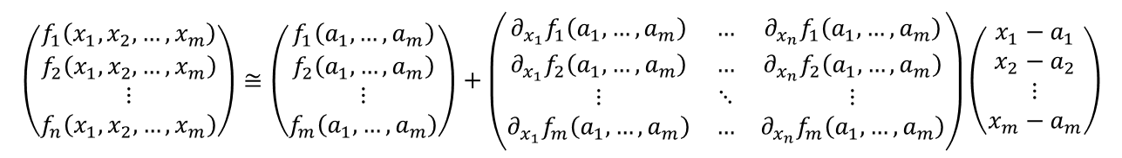
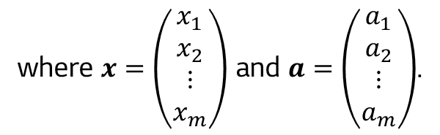

Lens Calibration
The Gauss-Newton method
If there are $n$ functions that each has $m$ variables, the first-order Taylor expansion is,
$$\left(\begin{matrix}f_{1}\left(x_{1},x_{2},…,x_{m}\right) \\ f_{2}\left(x_{1},x_{2},…,x_{m}\right) \\ ⋮ \\ f_{n}\left(x_{1},x_{2},…,x_{m}\right)\end{matrix}\right)≅\left(\begin{matrix}f_{1}\left(a_{1},…,a_{m}\right) \\ f_{2}\left(a_{1},…,a_{m}\right) \\ ⋮ \\ f_{m}\left(a_{1},…,a_{m}\right)\end{matrix}\right)+\left(\begin{matrix}∂_{x_{1}}f_{1}\left(a_{1},…,a_{m}\right) & … & ∂_{x_{n}}f_{1}\left(a_{1},…,a_{m}\right) \\ ∂_{x_{1}}f_{2}\left(a_{1},…,a_{m}\right) & … & ∂_{x_{n}}f_{2}\left(a_{1},…,a_{m}\right) \\ ⋮ & ⋱ & ⋮ \\ ∂_{x_{1}}f_{m}\left(a_{1},…,a_{m}\right) & … & ∂_{x_{n}}f_{m}\left(a_{1},…,a_{m}\right)\end{matrix}\right)\left(\begin{matrix}x_{1}−a_{1} \\ x_{2}−a_{2} \\ ⋮ \\ x_{m}−a_{m}\end{matrix}\right)$$
$$F\left(x\right)=F\left(a\right)+J\left(a\right)\left(x−a\right)$$
where $x=\left(\begin{matrix}x_{1} \\ x_{2} \\ ⋮ \\ x_{m}\end{matrix}\right)$ and $a=\left(\begin{matrix}a_{1} \\ a_{2} \\ ⋮ \\ a_{m}\end{matrix}\right)$.

Slide 15




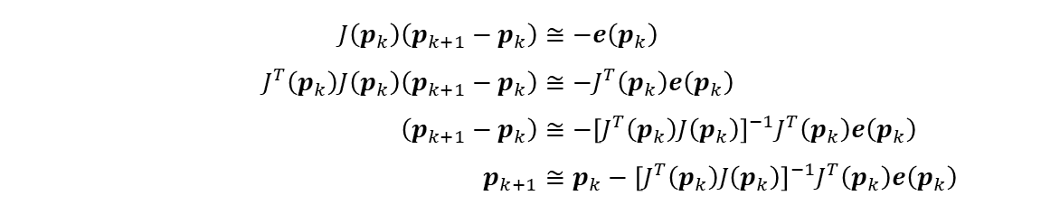
Lens Calibration
The Gauss-Newton method
$$F\left(x\right)≅F\left(a\right)+J\left(a\right)\left(x−a\right)$$
if we replace $F$ to $e$, $x$ to $p_{k+1}$and $a$ to $p_{k}$,
$$e\left(p_{k+1}\right)≅e\left(p_{k}\right)+J\left(p_{k}\right)\left(p_{k+1}−p_{k}\right)$$
We want $e\left(p_{k+1}\right)$ to be a zero vector, but the approximation will not be a zero vector.
$$e\left(p_{k+1}\right)=0 \\ e\left(p_{k}\right)+J\left(p_{k}\right)\left(p_{k+1}−p_{k}\right)≅0$$
Rearranging with respect to $p_{k+1}$, we get
$$J\left(p_{k}\right)\left(p_{k+1}−p_{k}\right)≅−e\left(p_{k}\right) \\ J^{T}\left(p_{k}\right)J\left(p_{k}\right)\left(p_{k+1}−p_{k}\right)≅−J^{T}\left(p_{k}\right)e\left(p_{k}\right) \\ \left(p_{k+1}−p_{k}\right)≅−{\left[J^{T}\left(p_{k}\right)J\left(p_{k}\right)\right]}^{−1}J^{T}\left(p_{k}\right)e\left(p_{k}\right) \\ p_{k+1}≅p_{k}−{\left[J^{T}\left(p_{k}\right)J\left(p_{k}\right)\right]}^{−1}J^{T}\left(p_{k}\right)e\left(p_{k}\right)$$

Slide 16
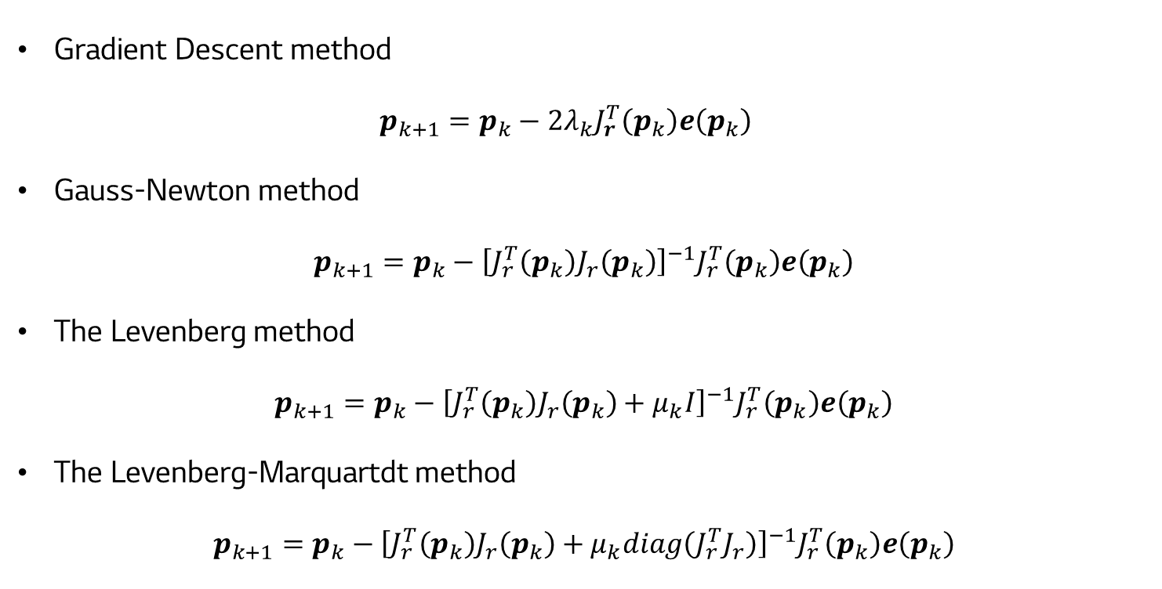
Lens Calibration
The Levenberg method
Gradient Descent method $p_{k+1}=p_{k}−2λ_{k}J_{r}^{T}\left(p_{k}\right)e\left(p_{k}\right)$
Gauss-Newton method
$$p_{k+1}=p_{k}−{\left[J_{r}^{T}\left(p_{k}\right)J_{r}\left(p_{k}\right)\right]}^{−1}J_{r}^{T}\left(p_{k}\right)e\left(p_{k}\right)$$
The Levenberg method $p_{k+1}=p_{k}−{\left[J_{r}^{T}\left(p_{k}\right)J_{r}\left(p_{k}\right)+μ_{k}I\right]}^{−1}J_{r}^{T}\left(p_{k}\right)e\left(p_{k}\right)$
The Levenberg-Marquartdt method $p_{k+1}=p_{k}−{\left[J_{r}^{T}\left(p_{k}\right)J_{r}\left(p_{k}\right)+μ_{k}diag\left(J_{r}^{T}J_{r}\right)\right]}^{−1}J_{r}^{T}\left(p_{k}\right)e\left(p_{k}\right)$

Slide 17

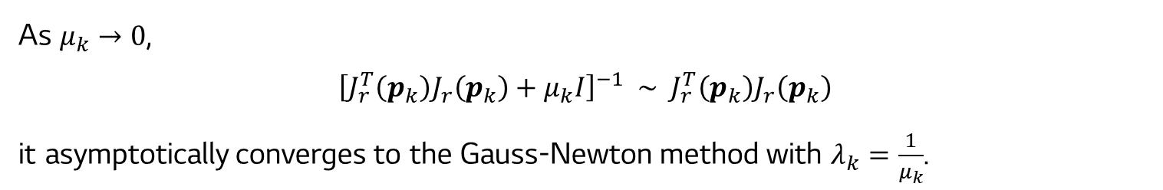
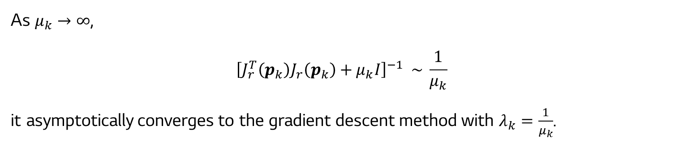
Lens Calibration
The Levenberg method
$$p_{k+1}=p_{k}−{\left[J_{r}^{T}\left(p_{k}\right)J_{r}\left(p_{k}\right)+μ_{k}I\right]}^{−1}J_{r}^{T}\left(p_{k}\right)e\left(p_{k}\right)$$
$μ_{k}$: Dampling factor
As $μ_{k}→∞$,
$${\left[J_{r}^{T}\left(p_{k}\right)J_{r}\left(p_{k}\right)+μ_{k}I\right]}^{−1} \sim \frac{1}{μ_{k}}$$
it asymptotically converges to the gradient descent method with $λ_{k}=\frac{1}{μ_{k}}$.
As $μ_{k}→0$,
$${\left[J_{r}^{T}\left(p_{k}\right)J_{r}\left(p_{k}\right)+μ_{k}I\right]}^{−1} \sim J_{r}^{T}\left(p_{k}\right)J_{r}\left(p_{k}\right)$$
it asymptotically converges to the Gauss-Newton method with $λ_{k}=\frac{1}{μ_{k}}$.

Slide 18


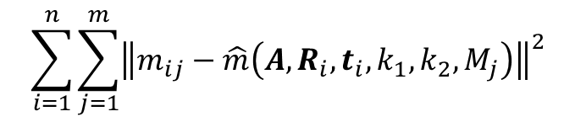

Lens Calibration
Maximum likelihood estimation
Maximum likelihood estimation can be obtained by minimizing the following function:
Zhengyou Zhang’s technique
$$\sum_{i=1}^{n}{\sum_{j=1}^{m}{{\left\|m_{ij}−\hat{m}\left(A,R_{i},t_{i},k_{1},k_{2},M_{j}\right)\right\|}^{2}}}$$
the Levenberg-Marquardt algorithm
where $\hat{m}\left(A,R_{i},t_{i},k_{1},k_{2},M_{j}\right)$ is the projection of point $M_{j}$ in image $i$ and $m_{ij}$ is the ideal coordinate of a point in an image plane.
$i$th image
$$⋯$$
$$⋯$$

